Slide 1


Microservices from the trenches
Scan to enter drawing at CGI booth
Planning and patterns that work
Presenter: Heath Murphy

Slide 2



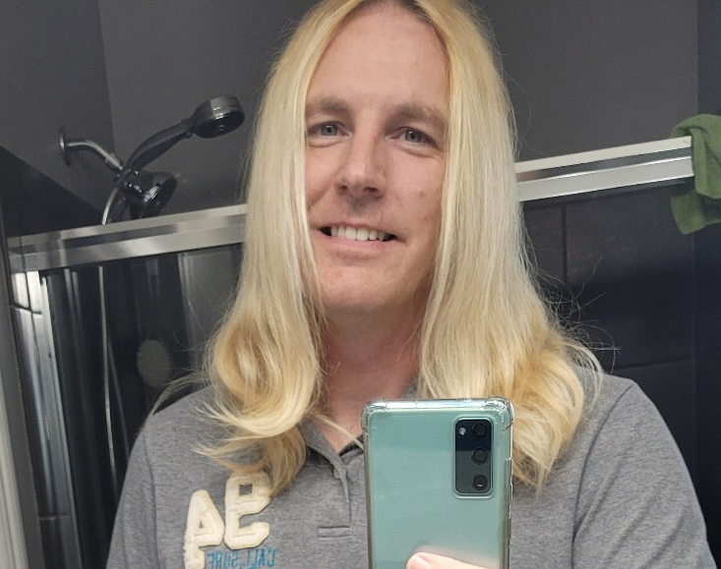

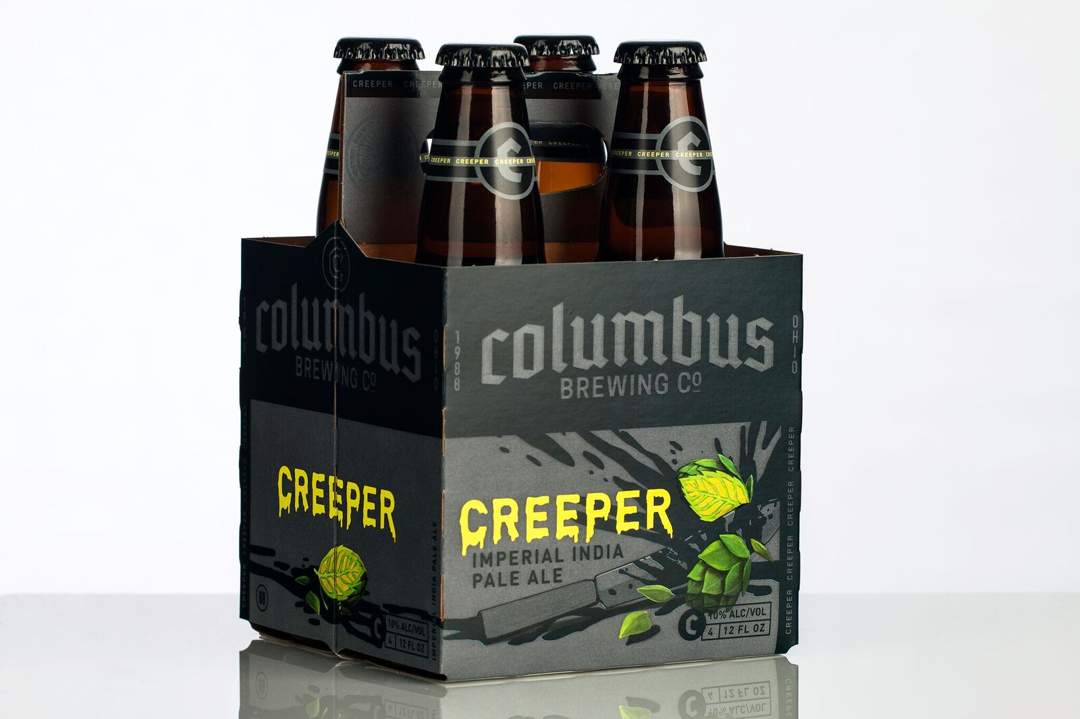


Heath murphy
Director, Consulting Services
I’m from Columbus, OH and therefore by state law I bleed Scarlet and Grey… O H!
This was my COVID hair… and I bet you have a story as well?? It’s real, I promise.
I have an unhealthy fascination with Pumpkin Ales… when those aren’t in season, I’ll take the dankest Imperial/Double IPA I can find.

Slide 3

Agenda
A BRIEF PROJECT RUNDOWN
PAUSE TO LEVELSET – MICROSERVICES
CORRELATED LOGGING & MONITORING
2. EVENTUAL CONSISTENCY
3. SELF HEALING PATTERNS
4. EXPECT THE UNEXPECTED

Slide 4
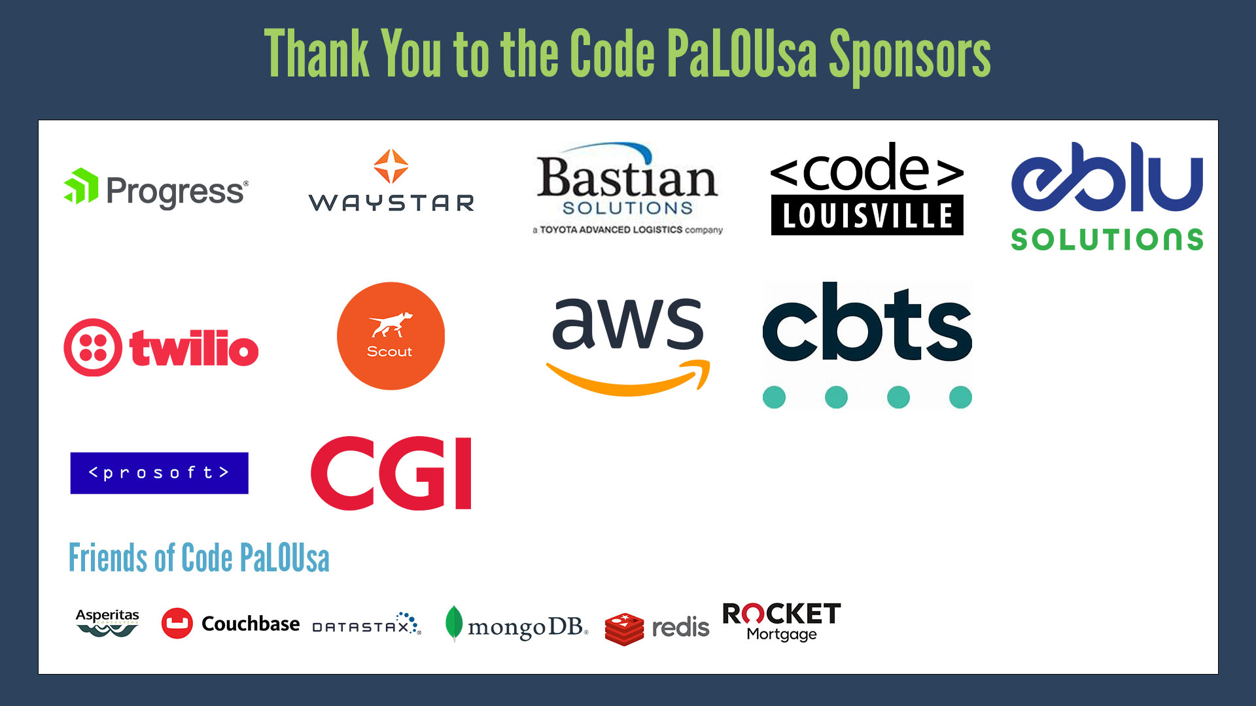

Slide 5

A BRIEF PROJECT RUNDOWN
Let’s Dive In

Slide 6
An ORDER FULLFILLMENT SYSTEM
US BASED SPECIALTY RETAILER
!!!
1,200+ BRICK AND MORTAR STORES
15+ ECOMMERCE WEBSITES
B2B PARTNER COMPANIES (5,000 STORES)
PAYMENT CAPTURE, ORDER MANAGEMENT
PICK, PACK, SHIP

Slide 7
SYSTEM Overview
THE LIFE OF AN ORDER
FLOW
Orders start out as fulfillment requests
Validation, stock reservations, warehouse submission comes next
Pick, pack and ship are the final steps on the journey
INGESTION
EDI FILES
FLAT FILES
A MILLION OTHER TYPES OF FILES
API REST SERVICE CALLS
DIRECT DATABASE ACCESS CALLS
MESSAGE QUEUE
INBOUND CUSTOMER PHONE CALLS
HARDWARE STREAMING DATA
TYPES OF MESSAGES (BUSINESS EVENTS)
NEW INBOUND ORDERS
CANCELLATION REQUESTS
UPDATE REQUESTS
SHIPPING VALIDATION
PAYMENT CAPTURE
VERIFICATION (RX)
INVOICE REQUESTS
OUTBOUND STATUS UPDATES
INVENTORY UPDATES

Slide 8

ECOM IS COMPLICATED!!
ORDER
FULLFILLMENT
SALES TAX
NO INVENTORY, REORDERS
MERCHANDISE RETURNS
INVENTORY MGMT
CUSTOMER SERVICE
SHIPPING PROVIDERS

Slide 9

DOCKER != EVERY ANSWER
WE NEED TO LEVEL SET ON MICROSERVICES

Slide 10




From Wikipedia:
There is no single definition for microservices. A consensus view has evolved over time in the industry. Some of the defining characteristics that are frequently cited include:
Services in a microservice architecture are often processes that communicate over a network to fulfill a goal using technology-agnostic protocols such as HTTP.
Services are organized around business capabilities.
Services can be implemented using different programming languages, databases, hardware and software environments, depending on what fits best.
Services are small in size, messaging-enabled, bounded by contexts, autonomously developed, independently deployable, decentralized and built and released with automated processes.
Platform agnostic

Slide 11


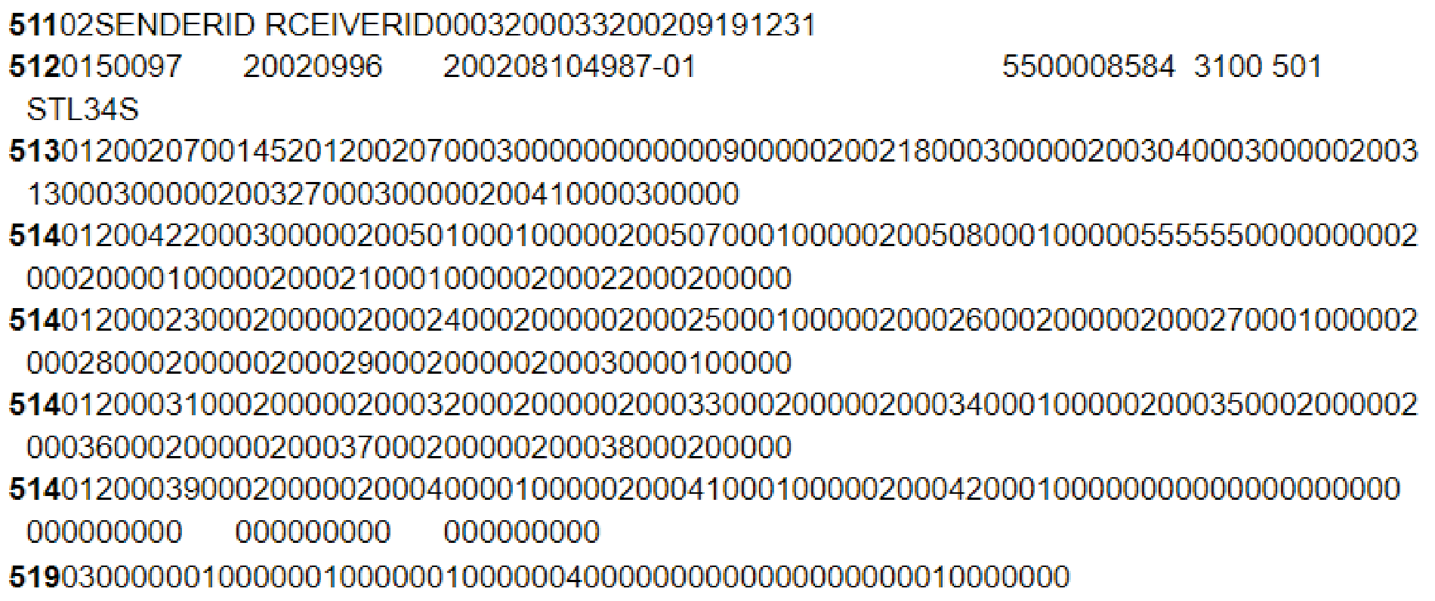


OUR MICROSERVICES ARCHITECTURE
ONE DATABASE | .NET SHOP | MESSAGING | OFF THE SHELF
TO RULE THEM ALL | ALL THE THINGS | WAIT IN QUEUE! | IT’S OK, I PROMISE
SQL SERVER A VERY large and legacy database at the center of it all. | C# Client is a .Net shop. We’ve got the full gamut, *.* of .Net. | RABBITMQ All things messaging is done in RabbitMQ. This is an EXTREMELY important part of the architecture and one first dismissed. | RSSBUS ARCESB I give up, it’s changed names so often. The point is leverage tools/products as needed. In this case we did not want to process EDI files in .Net. Gross!
Bonus ->

Slide 12
WHAT DID WE MISS?
NO CLOUD
NO CONTAINERS
NO MONGO-DB
AND WE CREATED AN AWESOME PLATFORM!

Slide 13

Correlated logging & monitoring
Saved our butts twice everyday!

Slide 14
ACTIVATE: LOGGING GREATNESS
MAKE LOGGING GREAT AGAIN!
HAPPY PATH LOGGING
CORRELATED LOGGING
AGGREGATOR PLATFORM
Pick a package (Ex: SeriLog) and boiler plate it in. Check for good logging in PRs. Use a standard template. It starts here, the easier it is to log the better logs you’ll have
Often overlooked and arguable more important. INFO log interesting happy path events and include payloads
Require correlation IDs in all inbound services. Reject calls without this critical attribute. More on this later!
Leverage a platform or DIY your own. Logs are only helpful when searchable

Slide 15
Monolith app
2021-09-30 13:49:40,161 INFO : Fulfilment validation OK
2021-09-30 13:49:45,273 INFO : Order Created successfully
2021-09-30 13:49:45,275 INFO : Rx Verified, 1 warning detected
2021-09-30 13:49:45,519 INFO : Payment capture successfully
2021-09-30 13:49:45,522 INFO : Order sent to warehouse
Fulfilment Validation
Verify Rx
Create Warehouse Request
Order Creation
Payment Capture
In Process Logging, all sequential

Slide 16
MICROSERVICE APP
Fulfilment Validation
Order Creation
Verify Rx
Payment Capture
Create Warehouse Request
Subservice
Subservice
Logs happen in dozens of processes!!

Slide 17

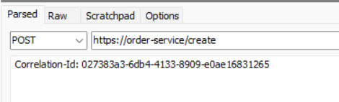
CORRELATED AND KEYED LOGS
CROSS REFERENCE LOG KEYS
Humans don’t use correlation IDs. They use natural business domain identifiers
Link all external business identifiers back to the log key
1
Order Number
CORRELATE IDs
2
External Partner Order Number
Use the same correlation ID for all logging in the same business transaction
Generate the correlation ID in the HEAD-IN service. GUIDs make fine IDs
Pass these along as a Header
Log Key
3
Warehouse Order Number
4
Shipment Tracking Number
5
Customer ID

Slide 18

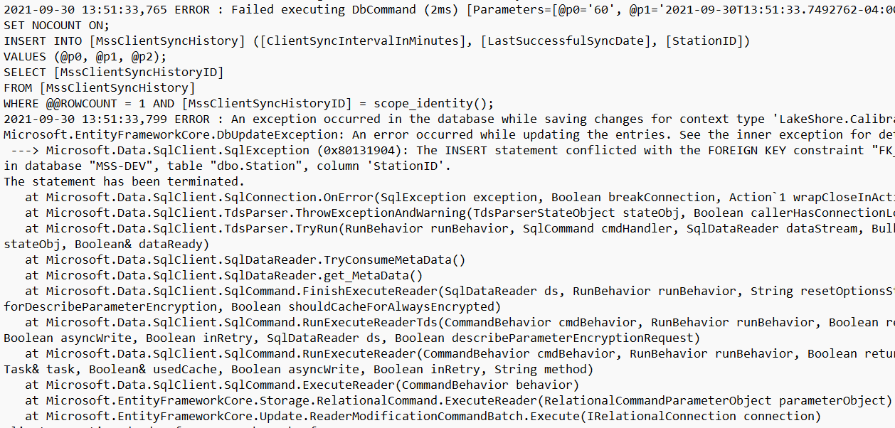

Finished product
Search by any external identifier
Correlation ID: 027383a3-6db4-4133-8909-e0ae16831265
Service | Time Stamp | Log | View Details
Fulfillment | 2021-09-30 13:49:40 | INFO: Request received. Basic validation passed | See Details
Fulfillment | 2021-09-30 13:48:40 | WARN: Message length close to threshold
Store Validation | 2021-09-30 13:48:40 | INFO: Passes validation, see details for response | See Details
…
Correlation ID: e78351bd-704f-4344-acf2-202b63f1caca
Service | Time Stamp | Log | View Details
Order Creation | 2021-09-30 13:49:40 | FATAL: Create order failed. See details for error | See Details Retry Request
Order Creation | 2021-09-30 13:48:40 | FATAL: Retry 1: Create order failed. See details for error | See Details Retry Request
Order Creation |  | FATAL: Retry 2: Create order failed. See details for error | See Details Retry Request
Aggregator platform

Slide 19

NO REALLY, WE DID AND THEY USED IT!
BUILD LOGGING FOR THE BUSINESS

Slide 20
Monitor everything
The Expected
Logs tell you what happened but not what hasn’t happened yet. Build monitoring around when things should have occurred but have not
Health Checks
https://order-service/healthcheck
Check connectivity, etc.
Monitor & React
We have a problem!
Message Queues
Depths, Dead letters
Synthetic Messages
Inject fake requests into correlated business transactions. Track SLAs on timing, errors, etc.
Error Logs
Set thresholds on the number of errors acceptable within a time window. Alert when excessive ERROR+FATAL logs occur

Slide 21
Eventual consistency
Saved our butts twice everyday!

Slide 22
What does eventual mean?
Order Creation
Search Order
EVENTUALLY
Message Queue
Transactional DB
Subservice
Subservice
Eliminate Coordinated Transactions

Slide 23
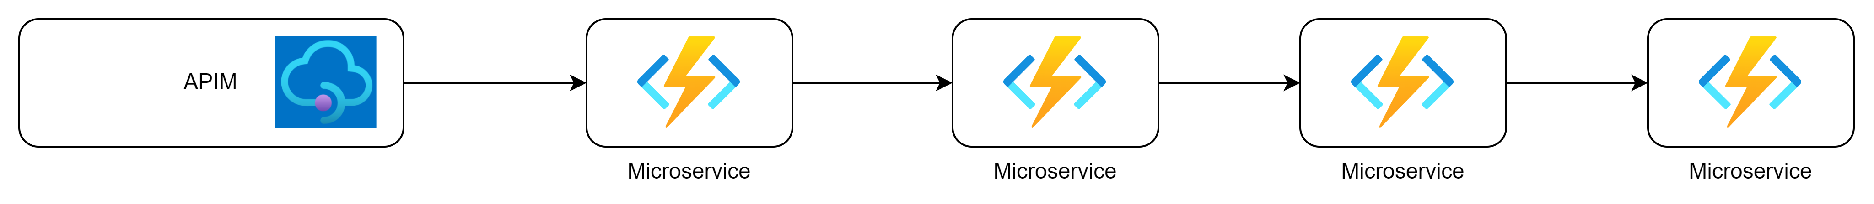
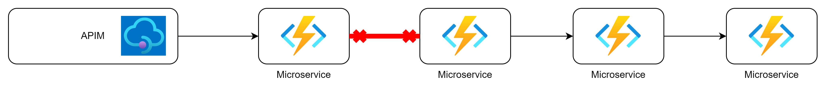
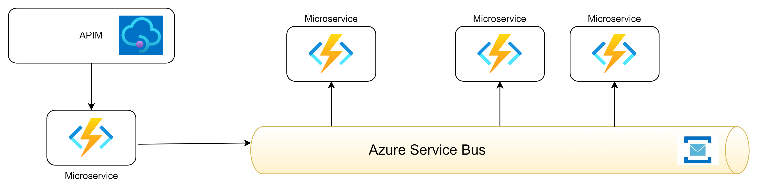
Why do we need this? I can build my microservice so I get data now!
Example Business Transaction
Holy Call Chain Batman!
One Broken Link
Brings down the entire chain
Eliminate Direct Calls
Isolates failure points, eliminates coordinated transactions, enables a self-healing environment

Slide 24


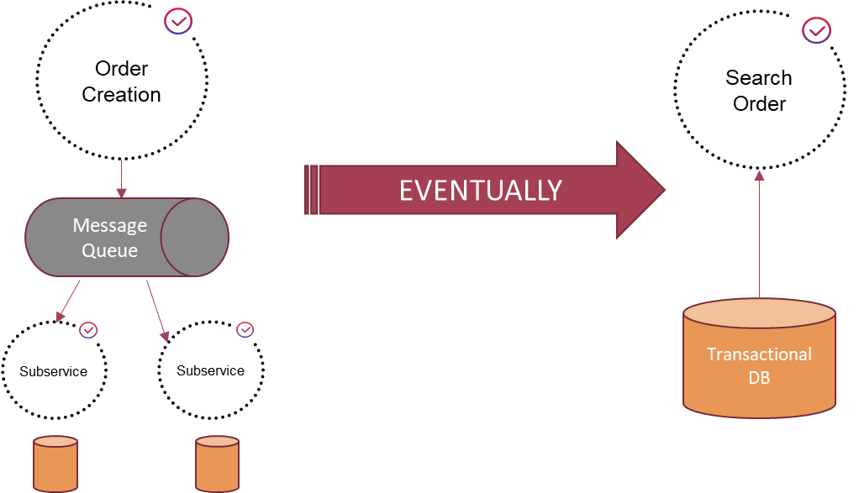
One way To achieve eventual consistency: cqrs
Command and Query Responsibility Segregation
Writes (Commands)
Often involve several systems and coordination
Are more tolerant to slow responses from users
Reads (Queries)
Speed is king, even at the cost of stale data
Data storage needs are much different than writes

Slide 25
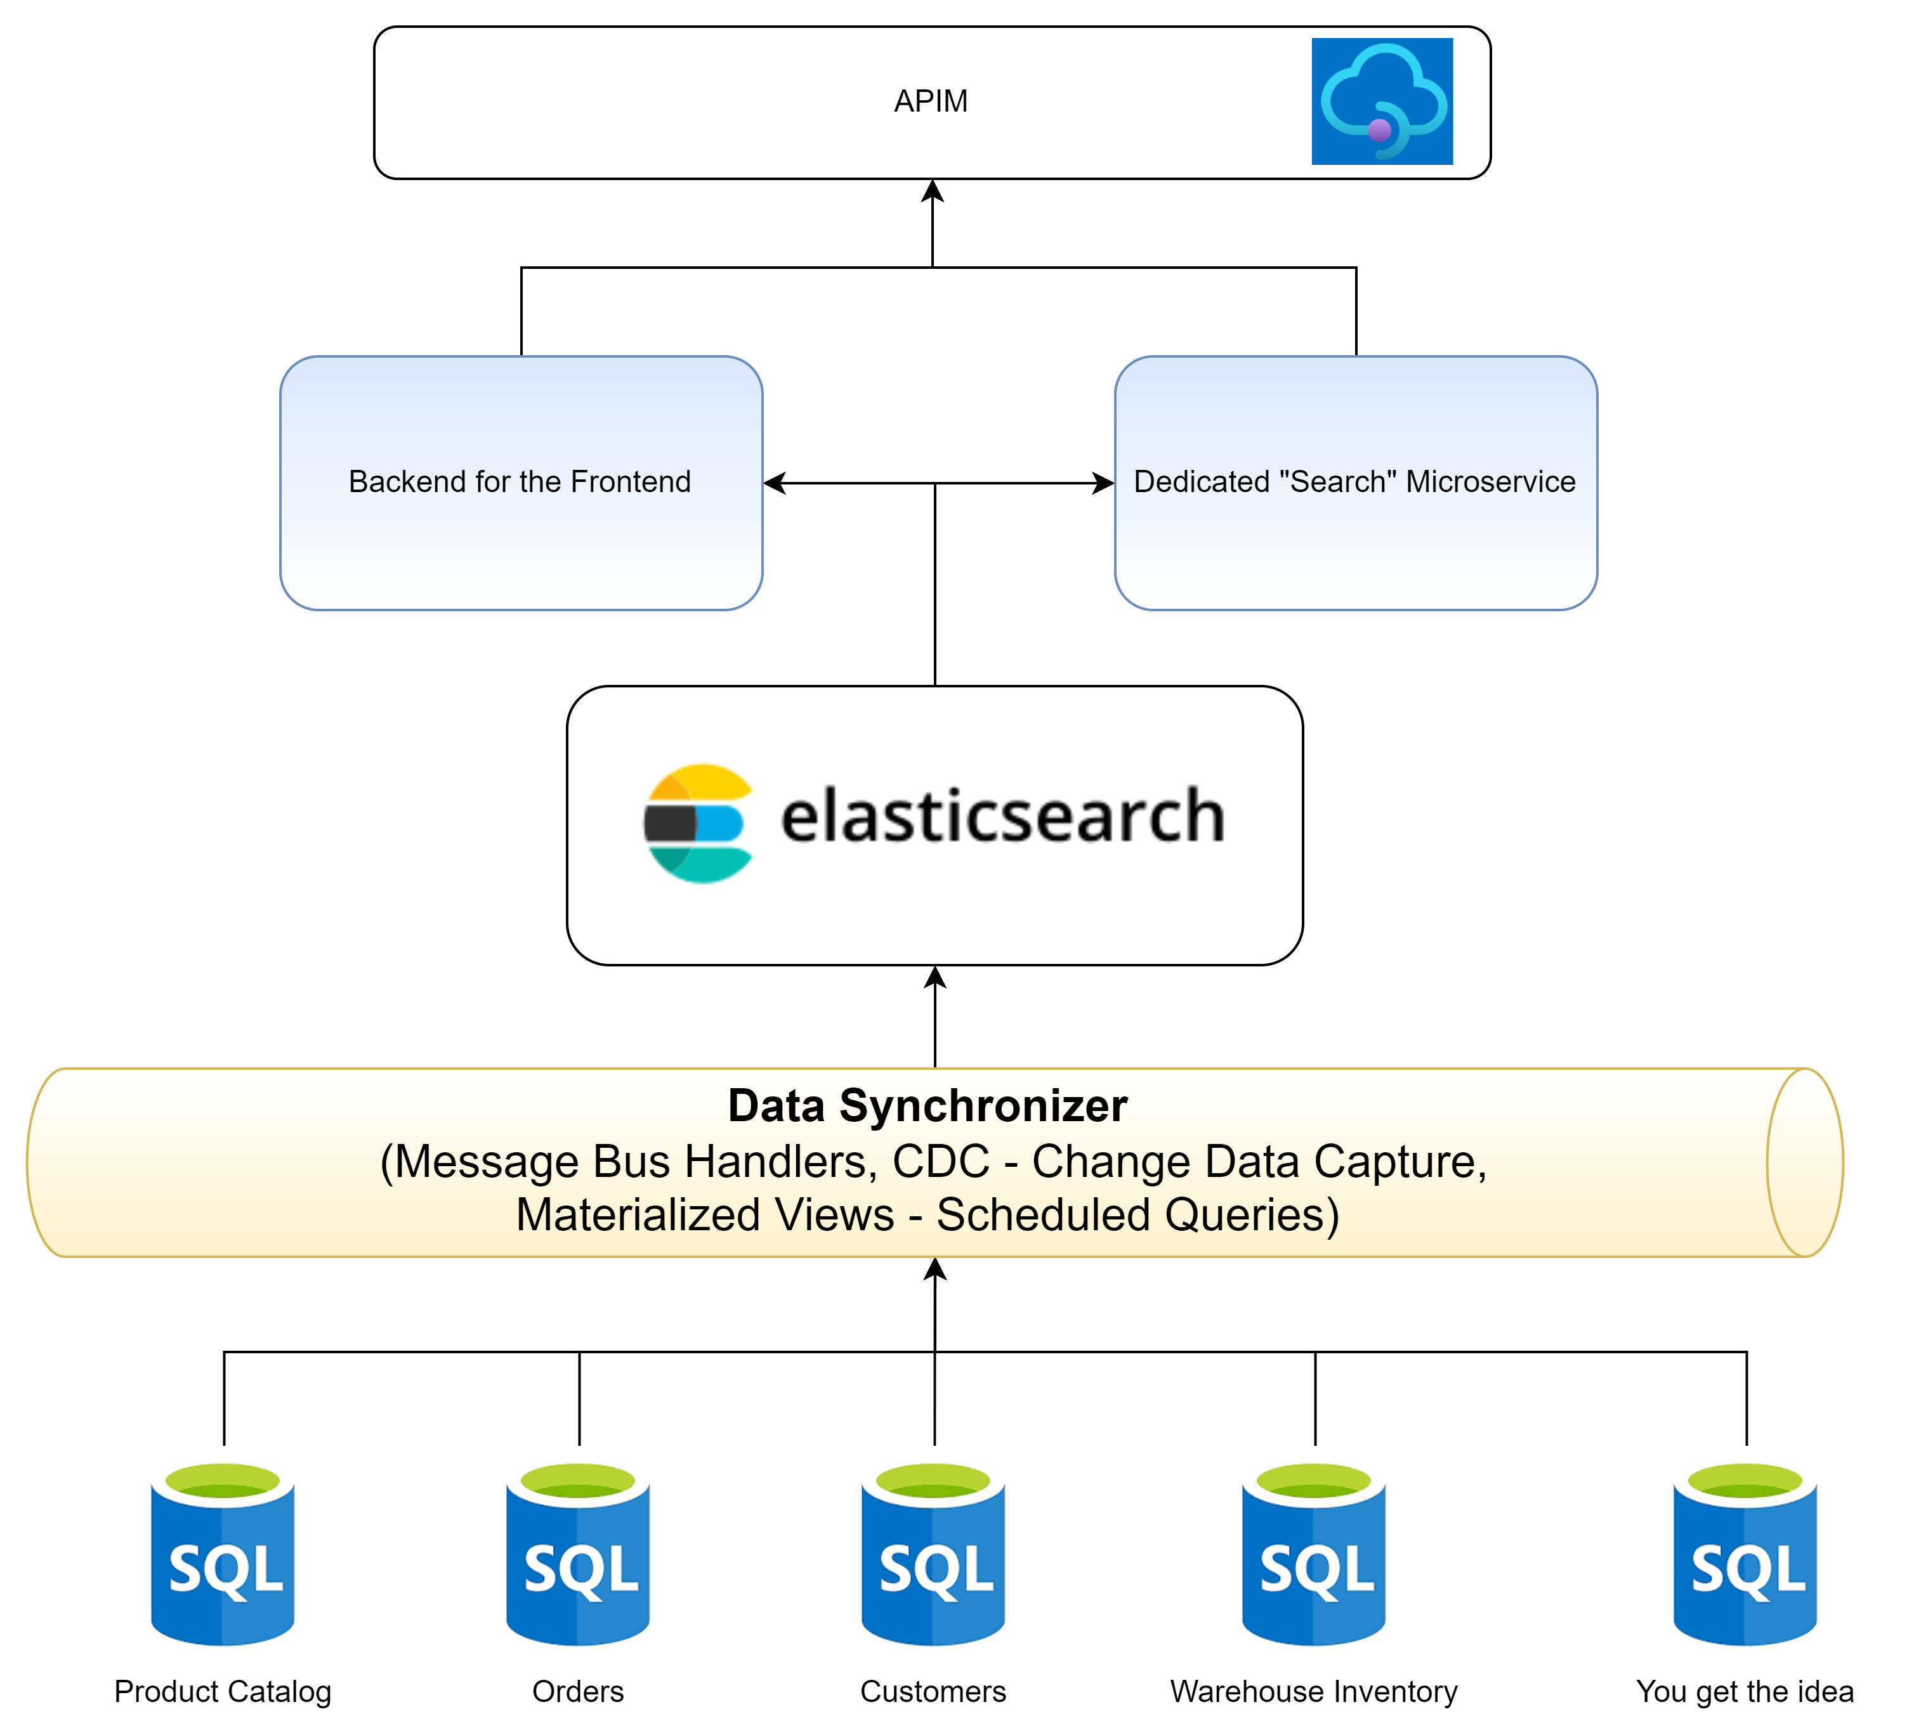
How did we do it?
I promised a bonus slide on elasticsearch

Slide 26
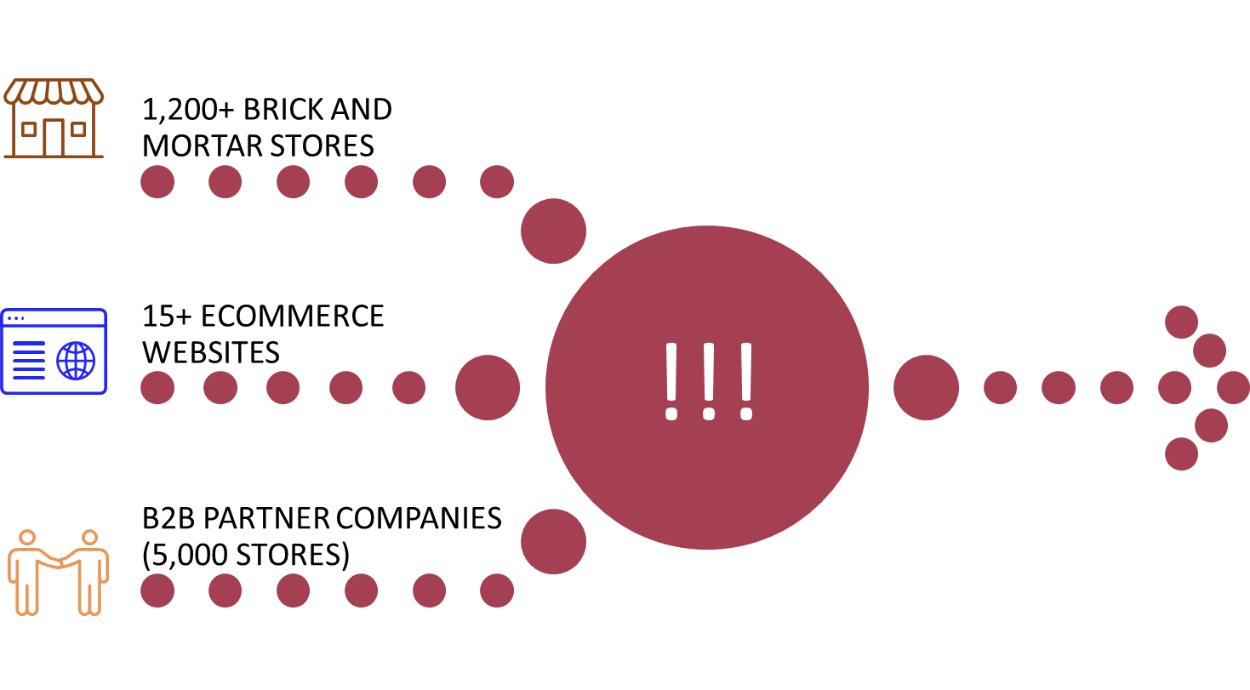
QUEUE-BASED LOAD LEVELING
INGESTION of Fulfilment Requests
12/store What they told us | ~100k We Calculated | 500k+ What Really Happened
Extremely Fast, few moving parts
Many moving parts, slower, eventual consistency
External Systems
Fulfillment Request Microservice
RabbitMQ
Fulfillment Handler Microservice
Basic Validation
Scales UP
Can handle bursty traffic like a champ
Transactional DB
Lightweight messages (JSON)
NO order details
Fetch full order details, perform full validation, leverage other microservices

Slide 27
LEVERAGE SERVICE BUS FOR DOMAIN EVENTS
Order Created
Fulfillment Request Accepted
Rx Verified
RabbitMQ
Fulfillment Request Received
Order Shipped

Slide 28
self healing patterns
Saved our butts twice everyday!

Slide 29
Automated retries, with backoff
01
02
03
04
Initial Service Request
Failed
Queue Message for Retry
Retry Message
Your Microservice handler interacts with a resource. Likely another Microservice or the database
The service call failed OR a network issues prevented the call. Activate retry logic.
Enqueue the message into a retry queue and increment the retry count by 1. Set the TTL (time to live) to exponentially backoff based on retry number.
TTL expires, the message now Re-Enqueues back into the primary message queue for a handler to pick up
ENTERPRISE SERVICE BUS (RABBITMQ)

Slide 30
Pick your POISON (MESSAGE) and dead-letter
After 3 retries, give up
Primary Queue
Dead-Letter Queue
Msg 1 (Retries 0)
Msg 1 (Retries 2)
Msg 1 (Retries 1)
Poison Msg 1 (Retries 3)
Poison Msg 2 (Retries 3)
Retry Queue
Msg 1 (TTL 10s)
Msg 2 (TTL 12s)
Msg 3 (TTL 15s)
Automated, based on TTL
Manual, requires humans
Dead-Letter should contain only Poison Messages, ones with a fault/error/edge case contained within the “data”.
It can quickly fill up with non-poison messages during an outage, we solve this with a Circuit-Breaker

Slide 31

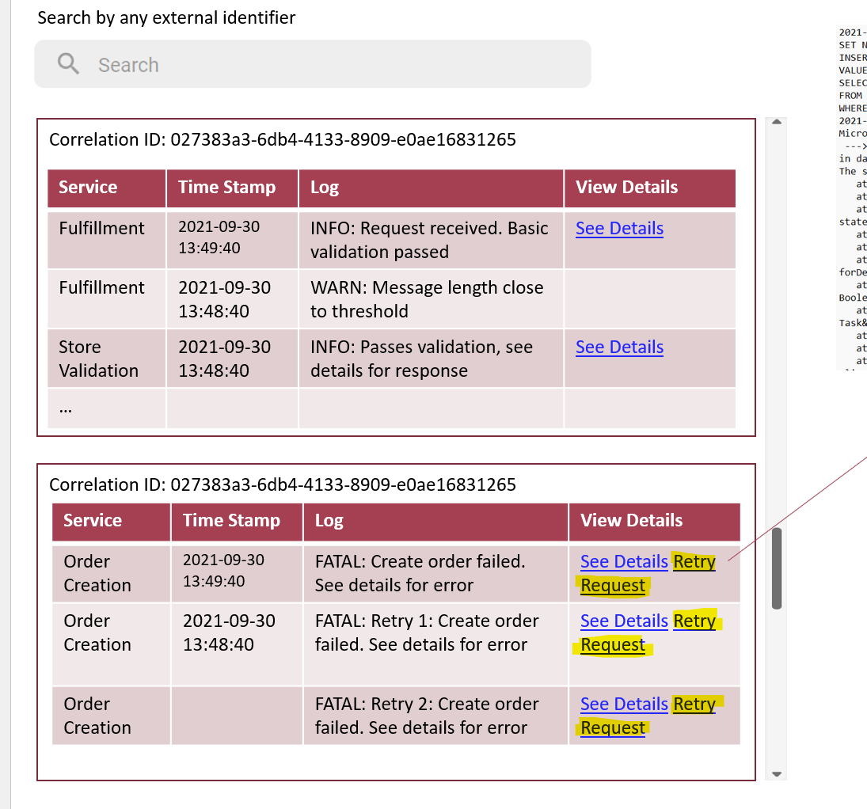
How do humans retry?

Slide 32
CIRCUIT BREAKER
1/2
Fulfillment Handler Microservice
Fulfilment Validation Microservice
RabbitMQ
Monitor for failures
Dead-Letter Queue
Hey guys, I’m filling up. We’re getting lots of errors in a short amount of time!
Fulfillment Handler Microservice
RabbitMQ
STOP, No more picking up messages. Let’s wait a bit

Slide 33
IDEMPOTENT SERVICES
“Idempotence is the property of certain operations in mathematics and computer science whereby they can be applied multiple times without changing the result beyond the initial application.”
- Wikipedia

Slide 34

Heath will guarantee that:
You will get identical messages/requests to your Microservices
Messages will be delayed at times. Never trust code that relies on timestamps to ensure Idempotency
Messages will sometimes arrive out of order
Eventual Consistency Comes at a Price!
Write code with Idempotency in mind
Test your Microservice with duplicate messages, Make it a PR checklist item
Protect your Microservice from edge cases (more to come!)

Slide 35
HUMAN’S MAKE MISTAKES
CASE IN POINT
Development Database
Production Database
Accidental Restore

Slide 36
CHECKPOINT “TRANSACTIONS” in your microservice
01
02
03
New Fulfillment Request
Validate Request
No Side effects, read-only operation. Always do this.
Create Order Header
Checkpoint 1: Wait a minute, is this already created???
06
05
04
Create Warehouse Order
Final Checkpoint: It’s possible Checkpoints 1 and 2 had already been done but not this final step. Let’s do it
Reserve Stock
Checkpoint 2: Maybe this was already reserved or may it have failed here last time. Maybe this is just a duplicate. We can handle all of these cases smartly
Get Stock Levels
No Side effects, read-only operation. Always do this.

Slide 37
PARTITION business transactions
Ext Partner D: Fulfillment Request Handler
Ext Partner C: Fulfillment Request Handler
All are instances of a
Fulfillment Request Handler
Ecom Site B: Fulfillment Request Handler
using a Partition Key
Ecom Site A: Fulfillment Request Handler
PROS:
Creates natural seams/pattern to scale out
We have control to turn on/off based on partition
Limit failures (open circuit breaker) to partition

Slide 38
EXPECT THE UNEXPECTED
Saved our butts twice everyday!

Slide 39

EDGE CASE MANAGEMENT 101
Guaranteed to Pop Up
Impossible to reason through all edge cases. Finite time and $ unless you design airline avionic systems.
Defensive Coding
Whitelist your business process flows. Kick out anything that doesn’t match. Don’t make assumptions in code!
Have humans review and handle edge cases. Requires time from a designated resource or team. Work the queue daily if not more.
DevOps Culture
Incorporate edge case fixes back into your sprint cycles
When practiced correctly, edge cases should only impact a small portion of the system/users.

Slide 40
Be prepared, be flexible
DO THESE:
Performance test bursty traffic prior to production
Be prepared to scale up/out or repartition based on actual production mileage
Stay Agile

Slide 41

THANK YOU
HEATH MURPHY
https://www.linkedin.com/in/heath-murphy-pmp-mcsd-39960542/
https://www.cgi.com

Slide 42


